Slide 1
Class Selectors VS. ID Selectors
By: Miles Noble

Slide 2
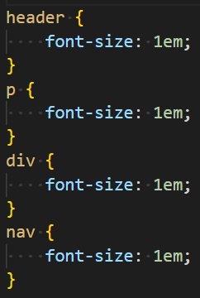
Element Selectors
Element selectors allow you to add styles to an entire HTML tag family.

Slide 3
Example

Slide 4
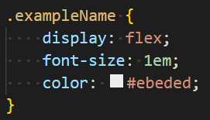
Class Selectors
A class selector allows you to apply styles to specified HTML tags using a unique class name.
You can then target the class in your CSS with a period and the class name.

Slide 5
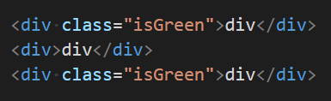
Adding A Class
To give an HTML tag a class all you need to do is add class= and the class name inside quotation marks.

Slide 6
Example

Slide 7

Multiple Class Selectors
You can add multiple classes to one HTML tag, simply by separating the class names with a space.

Slide 8
Example

Slide 9
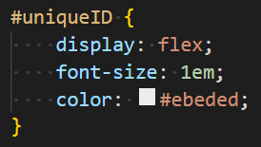
ID Selectors
An ID selector allows you to apply styles to one specified HTML tag using a unique ID name.
You can then use the ID selector in your CSS by using a hashtag before the name.

Slide 10
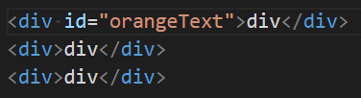
Adding An ID
Adding an ID to an HTML tag is similar to adding a class except you use id= instead of class= followed by the name.

Slide 11
Example

Slide 12
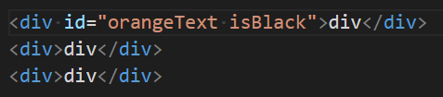
Multiple ID Selectors
You can only add one ID selector to an HTML tag.

Slide 13
Example

Slide 14

Mixing ID & Class Selectors
You can use ID selectors and Class selectors on the same HTML tag.

Slide 15
Example

Slide 16
Why Does It Matter?

Slide 17
Example

Slide 18
Please Ask Questions!

